Slide 1

COMPUTER SCIENCE
PRACTICAL FILE
(2019-2020)
Summer Fields School
(ISO 9001:2000, ISO14001:2004) DLF Qutab Enclave Complex, Phase-I Gurgaon-122001, Haryana, INDIA
NAME – Kartikay Sharma
CLASS – XII-A
ADMN.NO - 5308

Slide 2
CERTIFICATE
This is to certify that KARTIKAY SHARMA, a student of class XII (A) has successfully completed the Practical Work on COMPUTER SCIENCE (Python) under the guidelines of Mrs. SUSHMA SHARMA(Computer Teacher) during the year (2019-20) in partial fulfillment of the Computer Science Practical examination conducted by CBSE.
_____________________
Mrs. Sushma Sharma
(Computer - Science Teacher)
_____________________
External Examiner

Slide 3
ACKNOWLEDGEMENT
I would like to express my special thanks of gratitude to my teacher Mrs. Sushma Sharma, who gave me the golden opportunity to do this wonderful project of Computer Science on “PYTHON”, who also helped me in completing my project. I came to know about so many new things I am really thankful to them. Secondly I would also like to thank my parents and friends who helped me a lot in finalizing this project within the limited time frame.
Kartikay Sharma
Class-XII
Non-Medical

Slide 4
INDEX
S No. | Questions | Page No.
1 | WAP that takes a string with multiple words and capitalizes first letter of each word and forms a new string out of it.
2 | WAP that reads a string and checks whether it’s a palindrome or not.
3 | WAP that print the longest word in a string of words.
4 | WAP to sort a dictionary’s values using bubble sort and produce the sorted values as a list.
5 | WAP namely nthroot() that receives two parameters x and n and returns nth root of x.
6 | WAP that takes a no. n and then returns a randomly generated no. having exactly n digits.
7 | WAP that takes two numbers and returns a number that has minimum one’s digit.
8 | WAP that generates a series using a function which takes first and last values of a series and then generates four terms that are equidistant.
9 | Create a module for conversion of mass.
10 | WAP to count the words “to” and “the” present in a text file “poem.txt”.

Slide 5
S. No. | Questions | Page No.
11 | WAP that appends the contents of one file to another.
12 | WAP that reads characters from the keyboard one by one. All lower case character gets stored in the file LOWER , all upper case characters gets stored in file UPPER and all other characters gets stored in a file OTHERS.
13 | WAP and display the number of lines starting with alphabet “A” present in a text file “LINES.TXT” .
14 | WAP to display the greatest common divisor of two numbers.
15 | WAP hailstone sequence.
16 | WAP Happy numbers.
17 | WAP to Create a pie chart to check to check the amount of rainfall in jan separately.
18 | WAP to A line chart depicting the pries of the apps.
19 | WAP to binary search in an array.
20. | WAP to linear search in an array.
21 | WAP for insertion of an element in a sorted array using traditional algorithm.

Slide 6
S No. | Questions | Page No.
22 | WAP for deletion of an element from sorted linear list.
23 | WAP to implement stack.
24 | Give the output of he following statement: SELECT COUNT(DISTINCT SPORTS) FROM CLUB; SELECT MIN(Age) FROM CLUB WHERE SEX=‘F’; SELECT AVG(Pay) FROM CLUB WHERE SPORTS=‘KARATE’; SELECT SUM(Pay) FROM CLUB WHERE DOA>’1998-01-31’;
25 | Write SQL queries for the following: To display employee ids,names of employees,job ids with corresponding job titles. To display names of employees sales and corresponding job titleswho achieved sales more than 1300000. Identify foreign key in the table employee. Write SQL command to change the JOBID to 104 of the employee with ID as E4 in th e table ‘EMPLOYEE’.

Slide 7
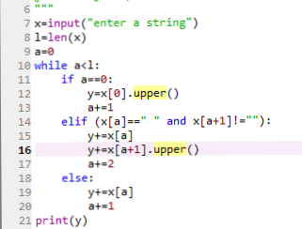

Q - 1 : WAP that takes a string with multiple words and capitalize first letter of each word and forms a new string out of it.
Source Code :
Output :

Slide 8
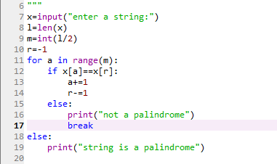

Q - 2 : WAP that reads a string and checks whether it’s a palindrome or not.
Source Code :
Output :

Slide 9
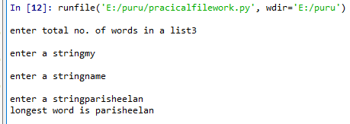
Q - 3 : WAP that print the longest word in a string of words.
Source Code :
Output :

Slide 10
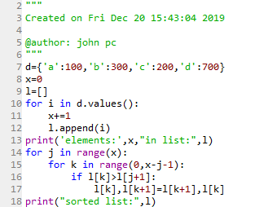

Q - 4 : WAP to sort a dictionary’s values using bubble sort and produce the sorted values as a list.
Source Code :
Output :

Slide 11
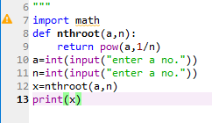
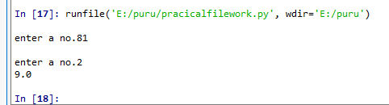
Q - 5 : WAP namely nthroot() that receives two parameters x and n and returns nth root of x.
Source Code :
Output :

Slide 12
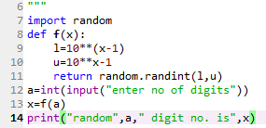

Q - 6 : WAP that takes a no. n and then returns a randomly generated no. having exactly n digits.
Source Code :
Output :

Slide 13
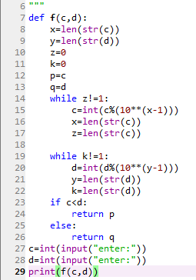
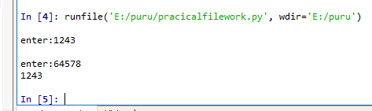
Q - 7 : WAP that takes two numbers and returns a number that has minimum one’s digit.
Source Code :
Output :

Slide 14

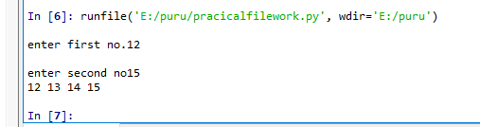
Q - 8 : WAP that generates a series using a function which takes first and last values of a series and then generates four terms that are equidistant.
Source Code :
Output :

Slide 15
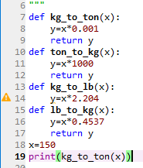

Q - 9 : Create a module for conversion of mass.
Source Code :
Output :

Slide 16
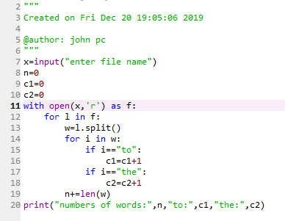
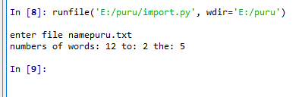
Q - 10 : WAP to count the words “to” and “the” present in a text file “poem.txt”.
Source Code :
Output :

Slide 17
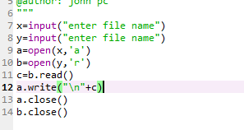
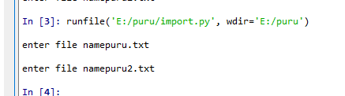
Q - 11 : WAP that appends the contents of one file to another.
Source Code :
Output :

Slide 18
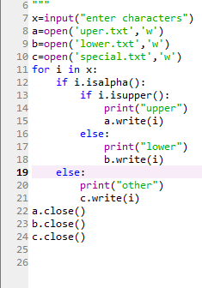
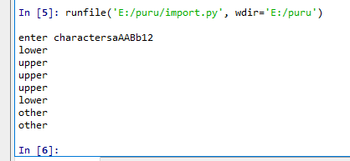
Q - 12 : WAP that reads characters from the keyboard one by one. All lower case character gets stored in the file LOWER , all upper case characters gets stored in file UPPER and all other characters gets stored in a file OTHERS.
Source Code :
Output :

Slide 19
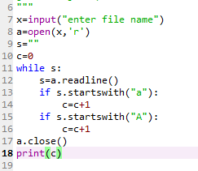
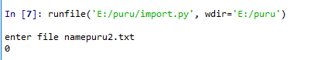
Q - 13 : WAP and display the number of lines starting with alphabet “A” present in a text file “LINES.TXT” .
Source Code :
Output :

Slide 20
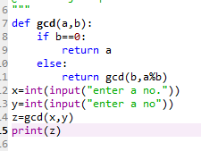
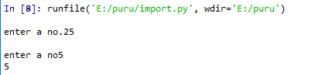
Q - 14 : WAP to display the greatest common divisor of two numbers.
Source Code :
Output :

Slide 21
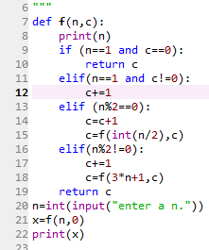
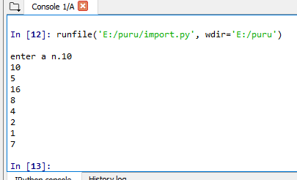
Q - 15 : WAP hailstone sequence.
Source Code :
Output :

Slide 22
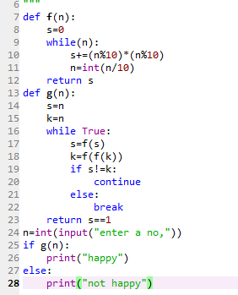
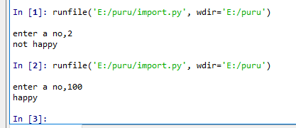
Q - 16 : WAP Happy numbers.
Source Code :
Output : `

Slide 23
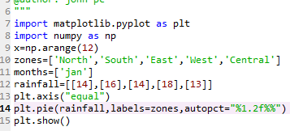
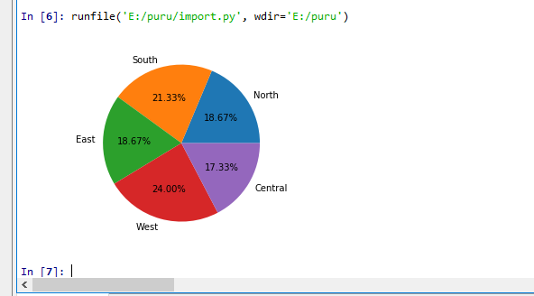
Q - 17 : WAP to Create a pie chart to check to check the amount of rainfall in jan separately.
Source Code :
Output :

Slide 24
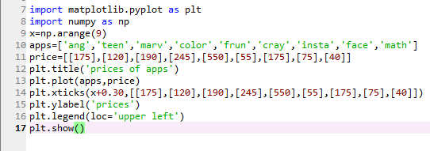
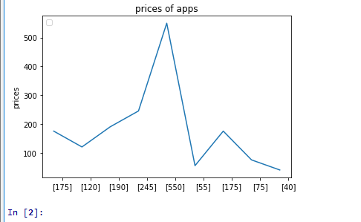
Q -18 : WAP to line chart depicting the pries of the apps.
Source Code :
Output :

Slide 25
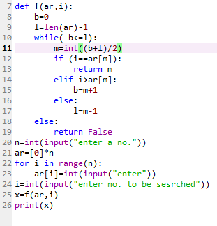
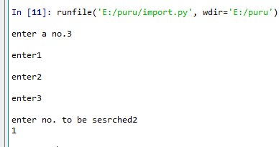
Q - 19 : WAP to binary search in an array.
Source Code :
Output :

Slide 26
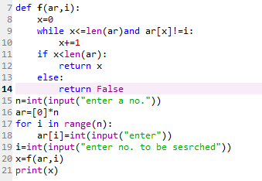
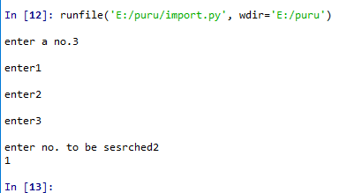
Q - 20 : WAP to linear search in an array.
Source Code :
Output :

Slide 27
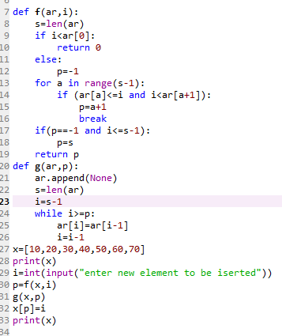
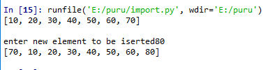
Q - 21 : WAP for insertion of an element in a sorted array using traditional algorithm.
Source Code :
Output :

Slide 28
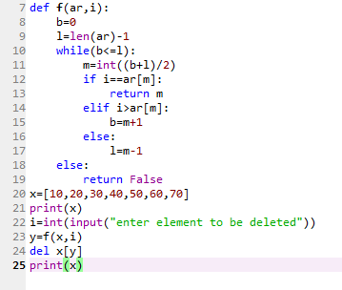
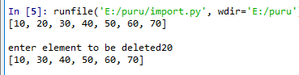
Q - 22 : WAP for deletion of an element from sorted linear list.
Source Code :
Output :

Slide 29
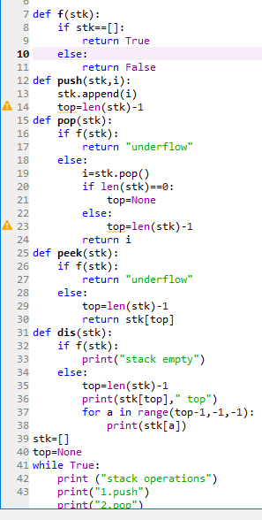
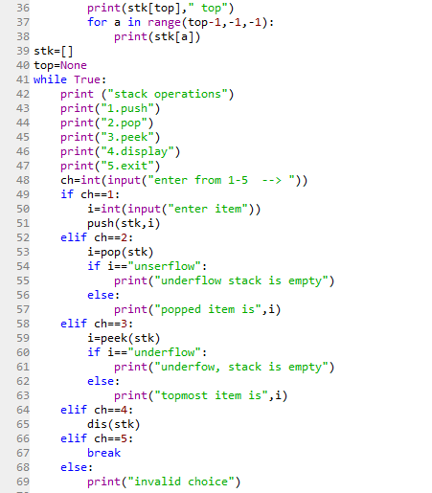
Q - 23 : WAP to implement stack.
Source Code :

Slide 30
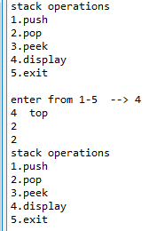
Output :

Slide 31
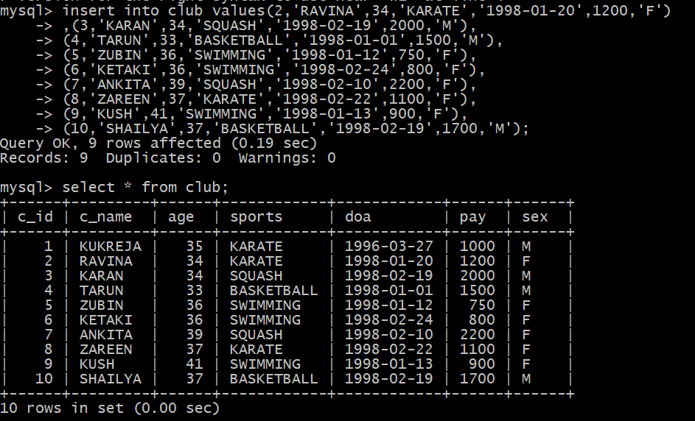
Q - 24 : Give the output of he following statement:
SELECT COUNT(DISTINCT SPORTS) FROM CLUB;
SELECT MIN(Age) FROM CLUB WHERE SEX=‘F’;
SELECT AVG(Pay) FROM CLUB WHERE SPORTS=‘KARATE’;
SELECT SUM(Pay) FROM CLUB WHERE DOA>’1998-01-31’;
Source Code & Output :

Slide 32
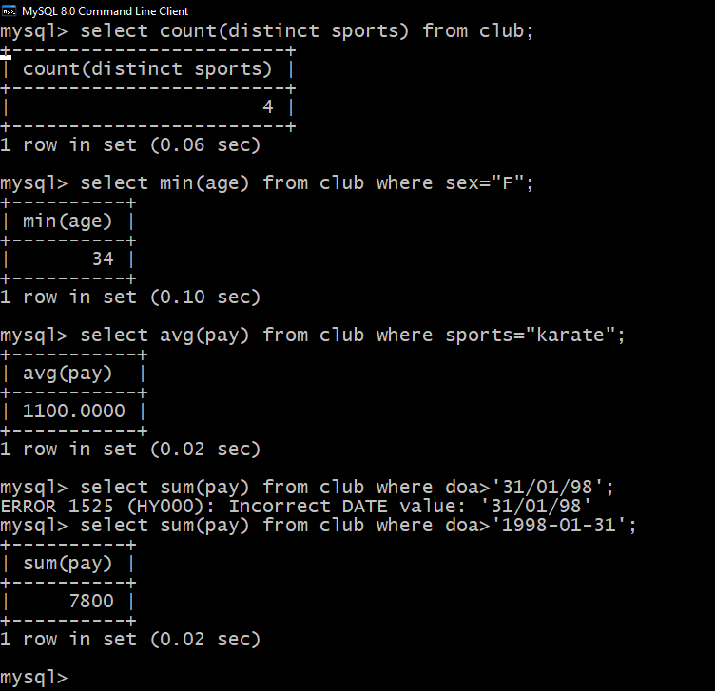

Slide 33
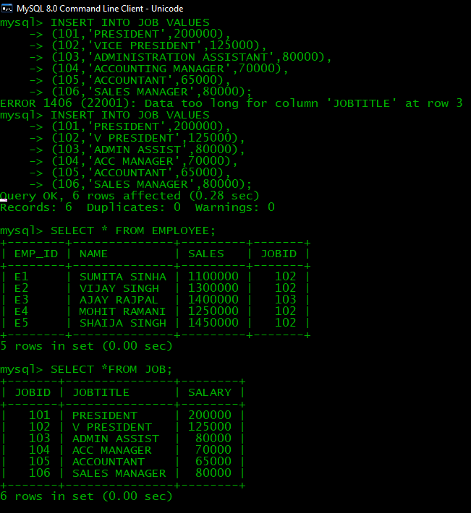
25 : Write SQL queries for the following:
To display employee ids,names of employees,job ids with corresponding job titles.
To display names of employees sales and corresponding job titleswho achieved sales more than 1300000.
Identify foreign key in the table employee.
Write SQL command to change the JOBID to 104 of the employee with ID as E4 in th e table ‘EMPLOYEE’.
Source Code & Output :

Slide 34
